Slide 1
ML Case Study
Made by AMAN GUPTA
(Data Analyst Intern at Teleperformance)

Slide 2
Problem Statement
Customers send back a substantial part of the products that they purchase online. Return shipping is expensive for online platforms and return orders are said to reach 50% for certain industries and products. Nevertheless, free or inexpensive return shipping has become a customer expectation and de-facto standard in the fierce online competition on clothing, but shops have indirect ways to influence customer purchase behavior. For purchases where return seems likely, a shop could, for example, restrict payment options or display additional marketing communication.

Slide 3
Objective
Model to predict return
Provide predictions for records in ‘TestingData_For_Candidate’ file

Slide 4
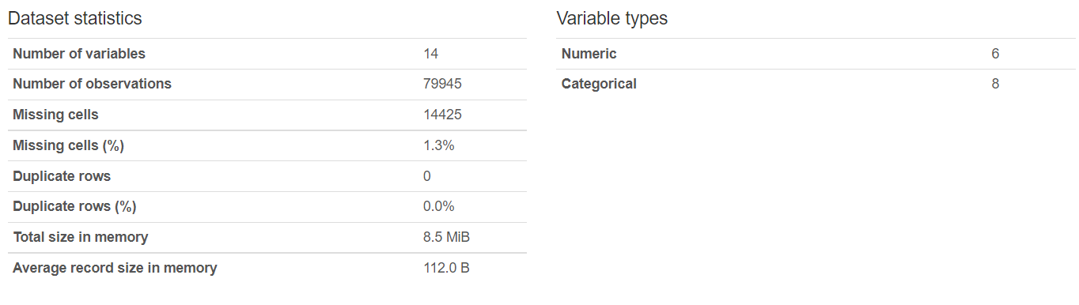
Dataset Statistics

Slide 5
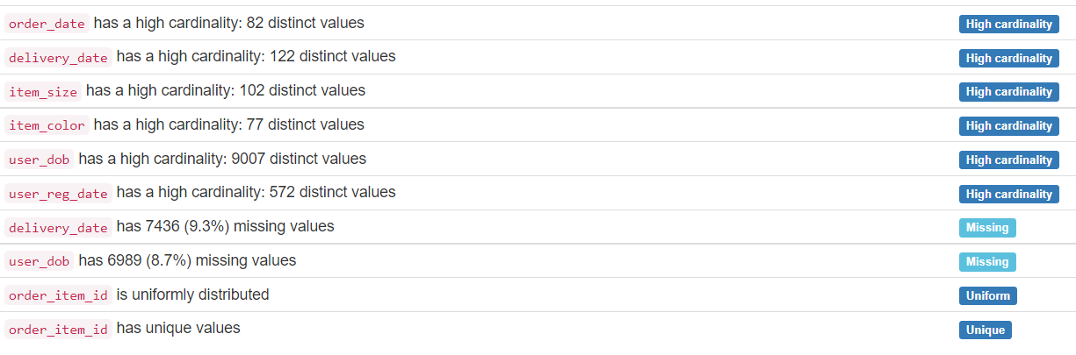
Some Key Insights of Dataset

Slide 6
Exploratory Data Analysis on Variables

Slide 7
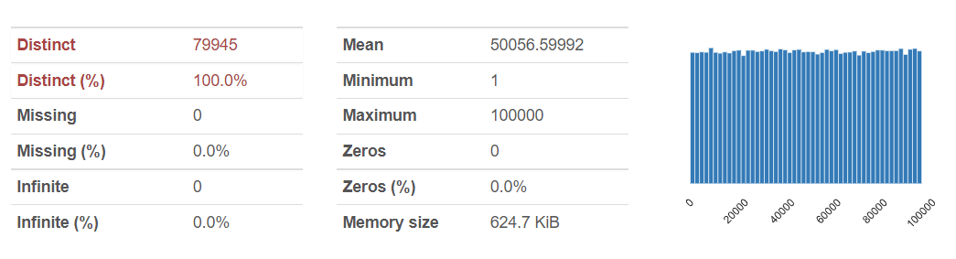
order_item_id
Since, every value is unique, we drop this column.

Slide 8
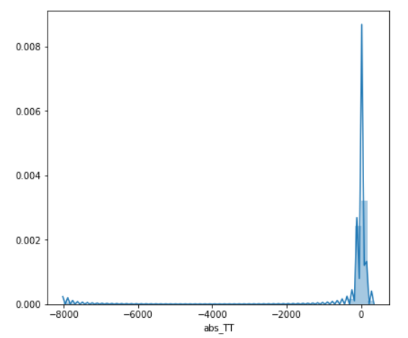
Order Date and Delivery Date
They individually do not provide any information. We derive the new feature time to take delivery.
For some orders, Delivery date is earlier than order date, which can’t be possible. Therefore, we take the absolute value of feature time to take delivery.
There’s some outliers, for example, Time taken is more than 7000. Therefore we replace those values with the reasonable extreme values.

Slide 9
Item Size and Item Color
After conducting some statistical test, we get to know that these variables don’t have much impact on our Dependent Variable. So, we decided to drop these columns.

Slide 10
Item ID and User ID
Item Id and User Id are not significant column directly.
We derive item return rate and user return rate, which shows some significant effect on our result.
For the missing item return rate or user return rate, we use the mean of the respective column to fill missing values.

Slide 11
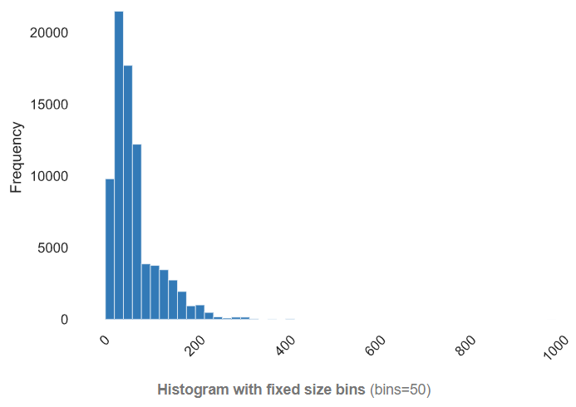
Item Price
Item Price is a Significant column in prediction
For some of the items with price 0, we replace the 0’s with the predicted price obtained using Random Forest.

Slide 12
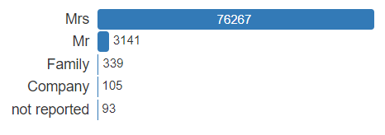
User Title
This column don not come out to be a significant column in prediction of return
So, we decided to drop this column.

Slide 13
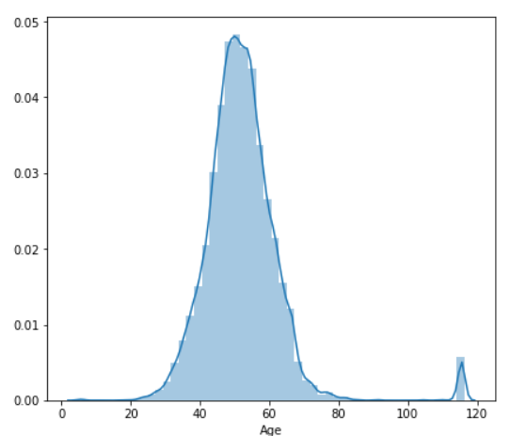
User Date of Birth
This column is used to Derive new column i.e. AGE.
Age for certain rows are very high, so we replace them with reasonable Extremes.

Slide 14
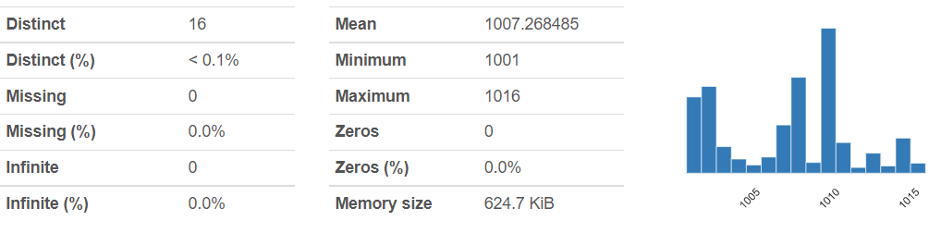
User State
This column is significant for prediction.
We change the origin of this column, by subtracting 1000 from it.

Slide 15
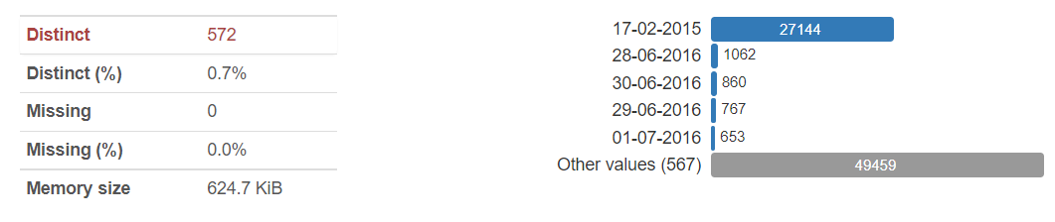
User Registration Date
We use this column to derive new feature i.e time betwwen registration and order.
This new feature indicate by how many years, the user is associated with our company which may also reflect their trust on us.

Slide 16
Evaluation Metrics for our Models
According to the problem, Accuracy and Precision will be the most focused metrics and we’ll try to maximize them as much as possible.

Slide 17
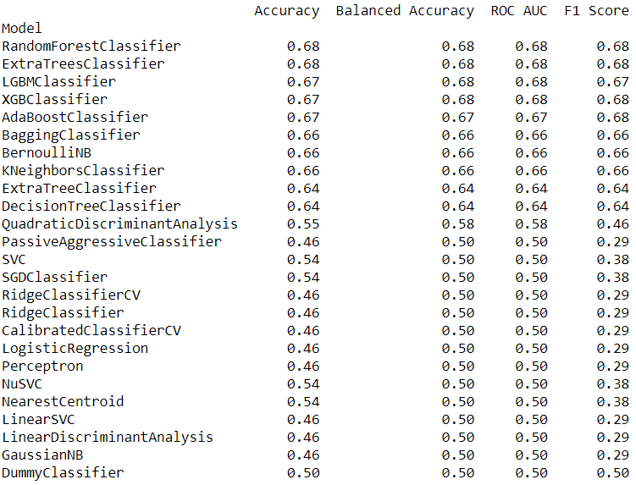
Models
We apply more than 20 models, to find out the most effective one.

Slide 18
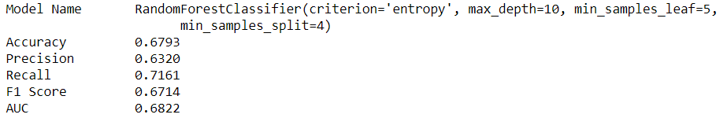
Best Model
Random Forest Comes out to be the best model.
We Hyper-tune our model, which increases it’s accuracy further

Slide 19
Thank You

